Slide 1
Speech recognition
BATCH NO: C_FS_19
18H51A05D4-SAIDEEKSHITHA
18H51A05D5-DHRUVA RAJU
18H51A05D6-GOPIKA

Slide 2
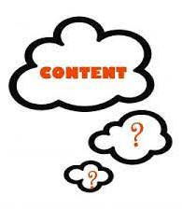

Contents:
INTRODUCTION
WHY IT IS IMPORTANT
WHERE IT CAN BE USED
MAIN PURPOSE
REQUIREMENTS
FLOW CHART
CODES
WORKING
ADVANTAGES
FUTURE SCOPE
CONCLUSION

Slide 3
SPEECH RECOGNITION:
Speech is the most common means of communication and the majority of the population in the world relies on speech to communicate with one another. Speech recognition system basically translates spoken languages into text. A speech recognition system overcomes this barrier by translating speech to text.

Slide 4
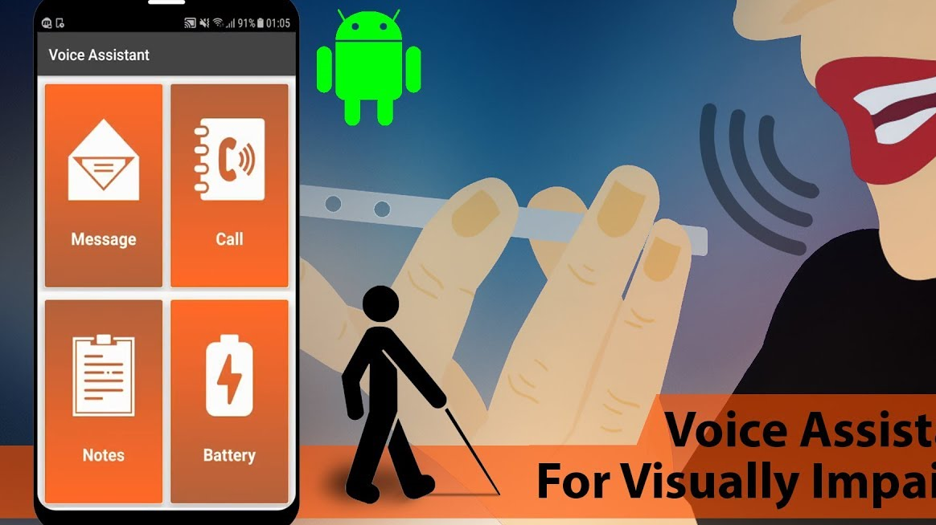
WHY SPEECH RECOGNITION IS IMPORTANT:
Roughly half the world speaks just one language – and very few people are fluent in more than two . Yet, Speechmatics’ any-context speech recognition engine can understand more than 30 languages .
Absolutely! people who are blind and visually devices just as much as sighted people. People who are blind just have different ways of accessing these devices. Blind people use what’s called assistive technology ,including screen readers,refreshable braille,and digital screen magnification to interact with high-tech products.

Slide 5

Where it can be used:
Dictation
System control / Navigation
Voice Dialing

Slide 6
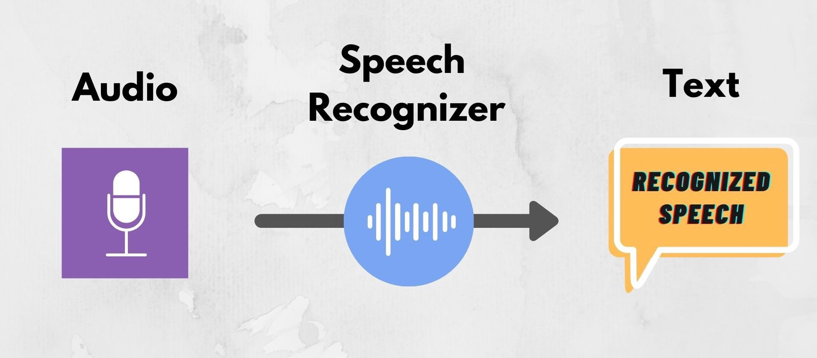
MAIN PURPOSE:
Our main purpose is speech recognition, also known as automatic speech recognition (ASR), computer speech recognition, or speech-to-text, is a capability which enables a program to process human speech into a written format.
Speech recognition enables hands-free control of various devices and equipment (a particular boon to many disabled persons), provides input to automatic translation, and creates print-ready dictation.

Slide 7
Requirements
python 3.3+ version
Speech Recognition module
use : pip install Speech Recognition
Pyaudio ( required only if u need to use microphone input)
use : pip install pyAudio

Slide 8
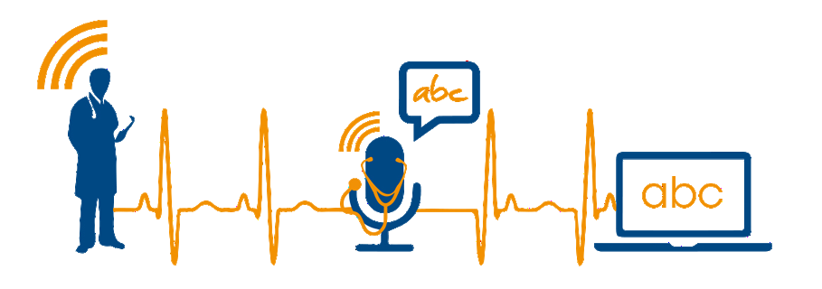
SPEECH-TO-TEXT

Slide 9
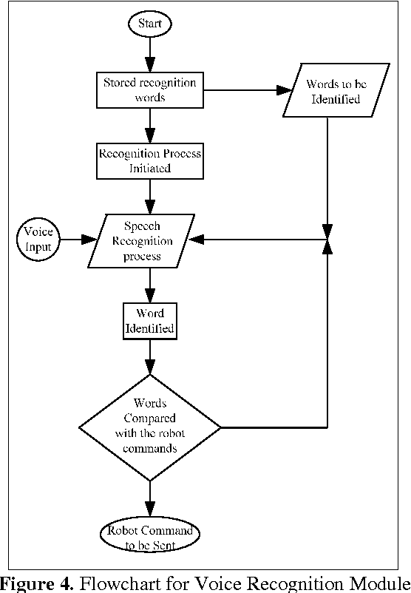
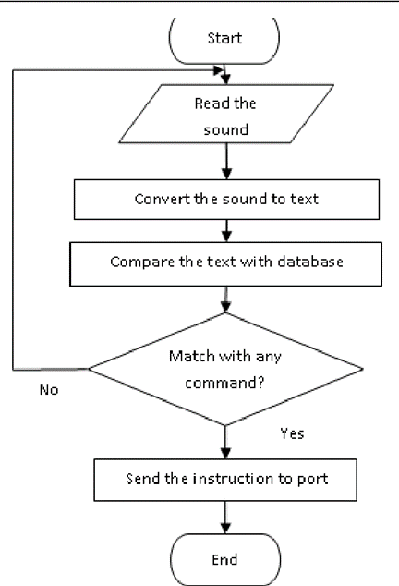
Flow chart of speech recognition

Slide 10
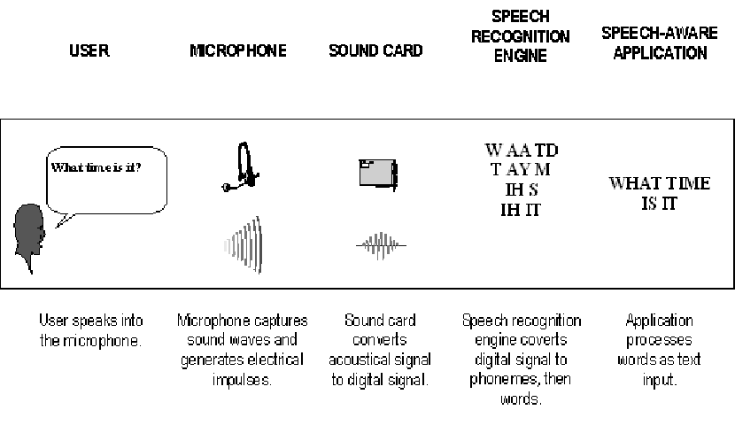
Working:
Speech recognition software works by breaking down the audio of a speech recording into individual sounds, analyzing each sound, using algorithms to find the most probable word fit in that language, and transcribing those sounds into text.

Slide 11
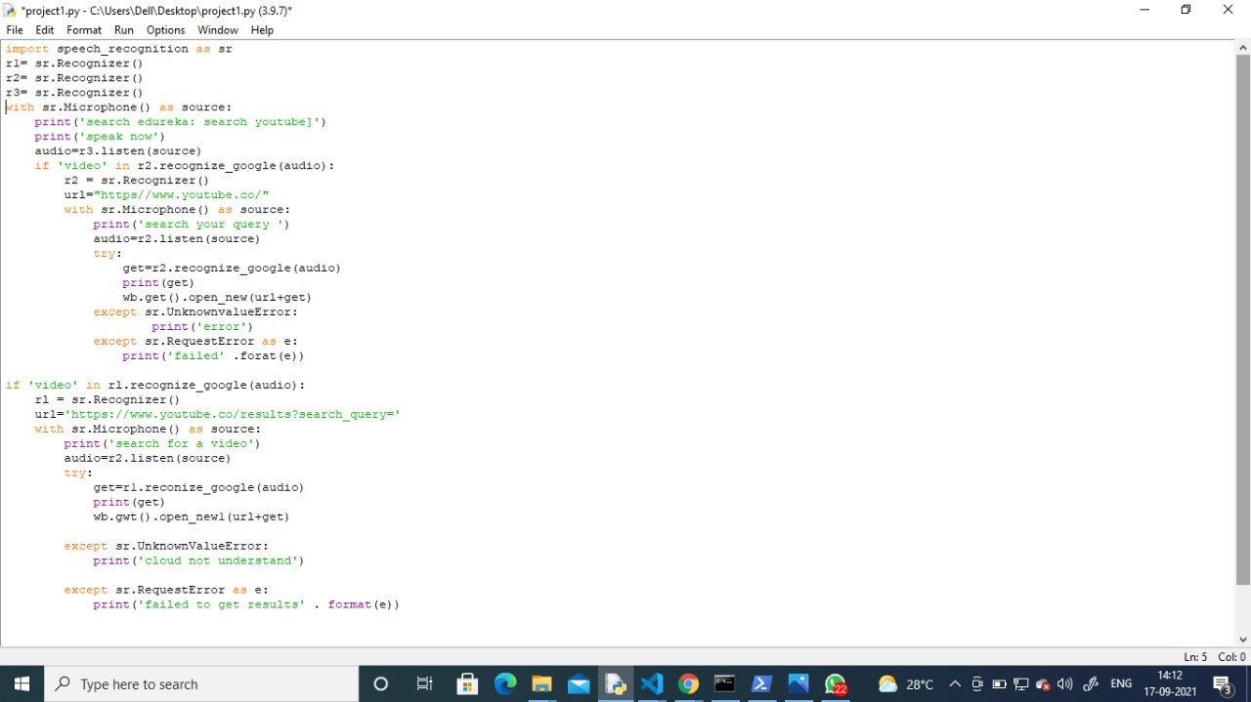
Code 1:

Slide 12
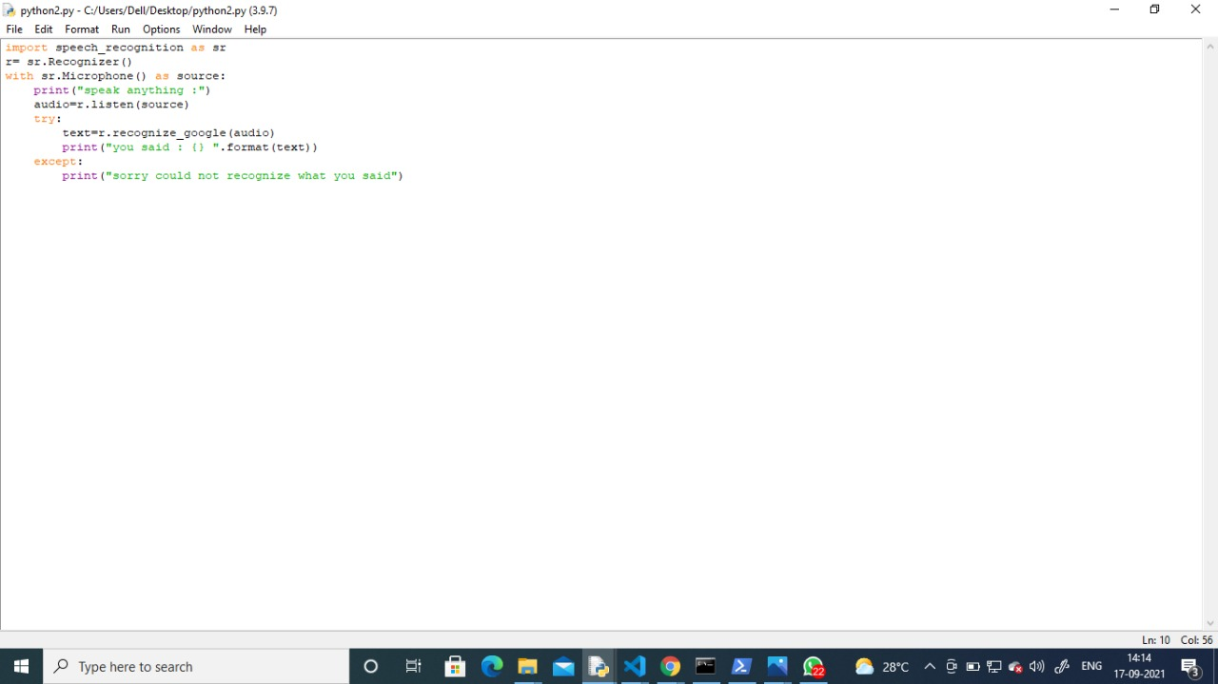
Code 2:

Slide 13
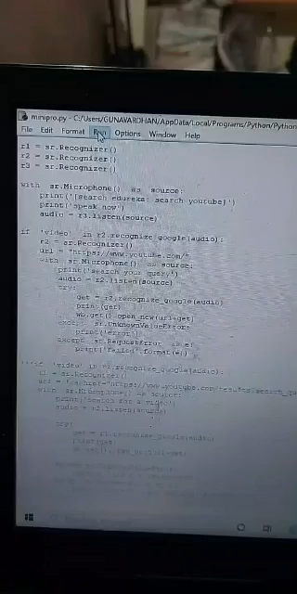
Execution of code 1:

Slide 14
Execution of code 2:

Slide 15
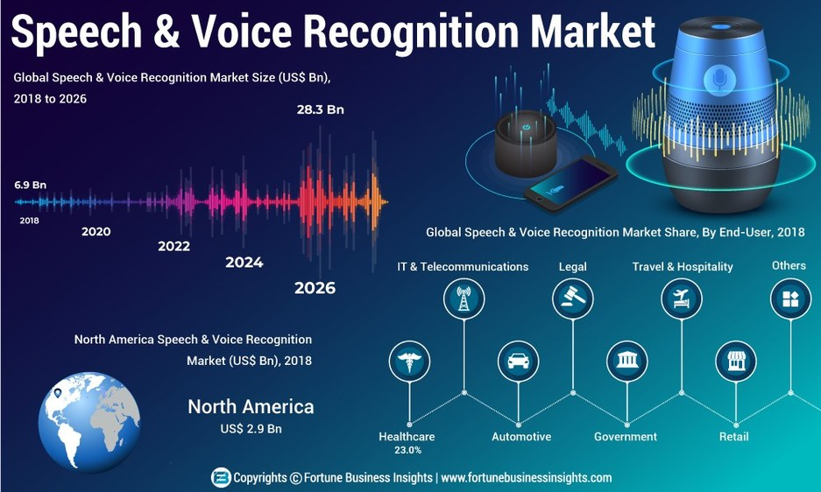

Slide 16
Advantages:
People with disabilities.
Organization-Increases productivity, reduces costs and errors.
Lower operational costs.
Advantages in technology will allow consumers and business to implement speech recognition systems at a relatively low cost.
Cellphone users can dial pre-programmed numbers by voice command.
Speech recognition technology can also replace touch-tone dialing resulting in the ability to target customers that speak different languages.

Slide 17
FUTURE OF SPEECH RECOGNITION:
Accuracy will become better and better.
Dictation speech recognition will gradually become accepted.
Small hand-held writing tablets for computer speech recognition dictation and entry will be developed as faster processors and more memory become available.
Microphone and sound systems will be designed to adapt more quickly to changing background noise levels , extraneous material to discarded.

Slide 18
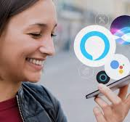
Conclusion:
The goal of this project was to create a speaker recognition system, and apply it to a speech of an unknown speaker. By investigating the extracted features of the unknown speech and then compare them to the stored extracted features for each different speaker in order to identify the unknown speaker.

Slide 19

THANK YOU

